Slide 1

ECOLE –
Eyetracking COmparison of LEssons
Mandy Klatt
01/02/2023
Empirical School and Classroom Research

Slide 2
Theoretical background
teachers require different approaches for math and literacy (Leshem & Markovits, 2013)
teachers' beliefs play a crucial role:
mathematics is a formal way of representing reality; students should acquire a collection of skills and algorithms (Zakaria & Musiran, 2010)
creativity in language literacy is expressed by the variety of interpretations and the inclusion of students' personal experience (Leshem & Markovits, 2013)
discrepancies in teacher's beliefs lead to adoptions of different teaching strategies and class practices
Theoretical Background • Research Question • Method

Slide 3
Theoretical background
Huang (2018) investigated teachers’ gaze behavior for two subjects:
  10 teachers taught Literacy and Math (45min) with 10 classrooms
  each teacher taught both subjects to the same group of students in the same classroom, but on different days
  ASL Mobile Eye system recorded teacher's eye movement
  results:
    Distribution of fixations (Attention): Math = Literacy
    Fixation duration (Monitoring) on students: Literacy > Math
    Fixation count Monitoring on students: Literacy > Math
Theoretical Background • Research Question • Method

Slide 4
Theoretical background
Huang (2018):
  small sample (N = 10)
  investigated only teachers’ oculomotor behavior
research gap related to teacher behavior in different subjects
deeper understanding of teacher behavior in two subjects (Math and French)
combination of new methodological approaches (eye tracking, indoor tracking, questionnaire, etc.)
Theoretical Background • Research Question • Method

Slide 5
Research Question
Do math and literacy teachers’ differ in their …
  eye movements
  physiological measures
  behavioral patterns
  (subject) beliefs / self-concepts?
What is the role of students’
  skill level
  anxiety state
  self-confidence
  enjoyment?
Theoretical Background • Research Question • Method

Slide 6

METHOD
planned SAMPLE
N = 20 teachers of CM2
  primary school teachers
N = 28 students of 6th grade
  depending on the size of the class
  class is split in two equal parts
  background information about students: grade in French and Math
Theoretical Background • Research Question • Method

Slide 7
METHOD
DESIGN & Procedure
French
Math
In the morning
Math
French
In the afternoon
→ The order of French and Math lessons is counterbalanced within the class
Theoretical Background • Research Question • Method
Notes:
The teacher and their class are on site (Marseille) for a day.
The day start with the installation of the eye tracker and the bracelet and a short time (10min) with the teacher alone to record this moment as a baseline of the physiological measures.
The class is split in two equal parts.
Then, a period of 5min of habituation for the students to discover the teacher with the glasses.
Each group of students will receive a literacy and a mathematics lesson. Each lesson is followed by a questionnaire on tablets.
First group: morning; second group: after noon.
The order of literacy and mathematics are counterbalanced within the class.

Slide 8
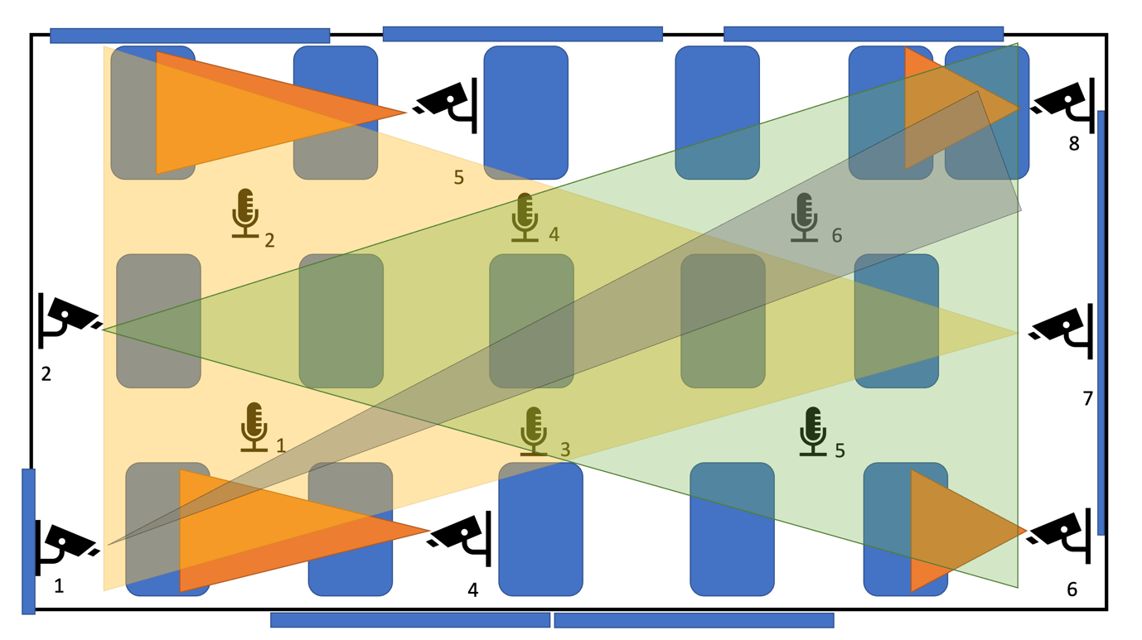
METHOD
DESIGN & Procedure
Theoretical Background • Research Question • Method

Slide 9
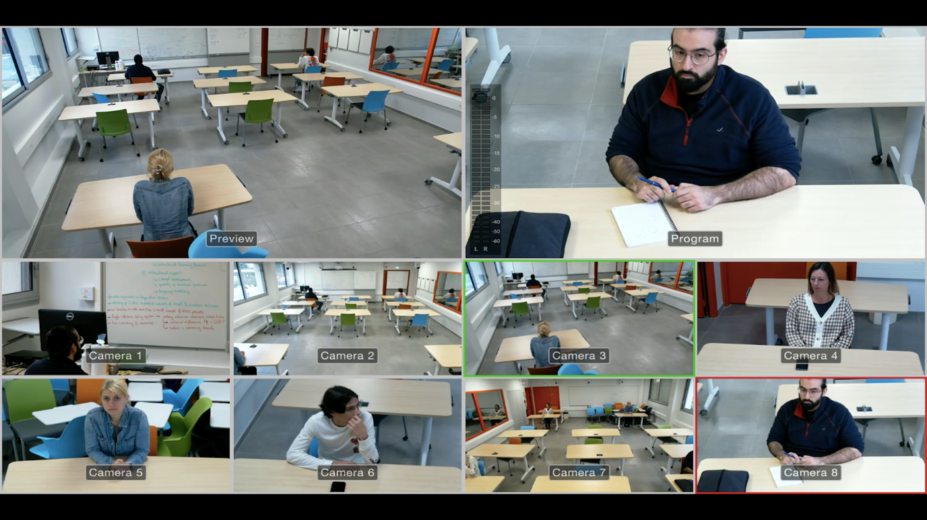
METHOD
DESIGN & Procedure
Theoretical Background • Research Question • Method

Slide 10
METHOD
DESIGN & Procedure
20min lessons:
  9 min teacher centered activity → "common" time
  2 min transition
  9 min student centered activity → example
French: "the conjugation“
Mathematics: "the orders of magnitude"
Theoretical Background • Research Question • Method

Slide 11
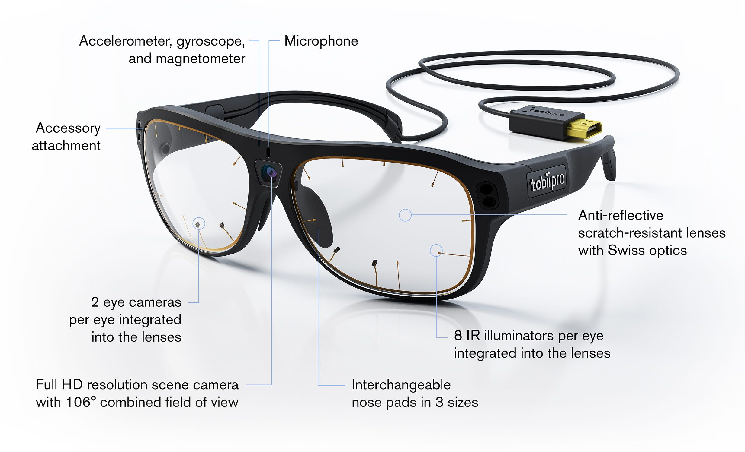
METHOD
INSTRUMENTS
TEACHER - EYE TRACKING DATA
Tobii Glasses 3
Theoretical Background • Research Question • Method

Slide 12
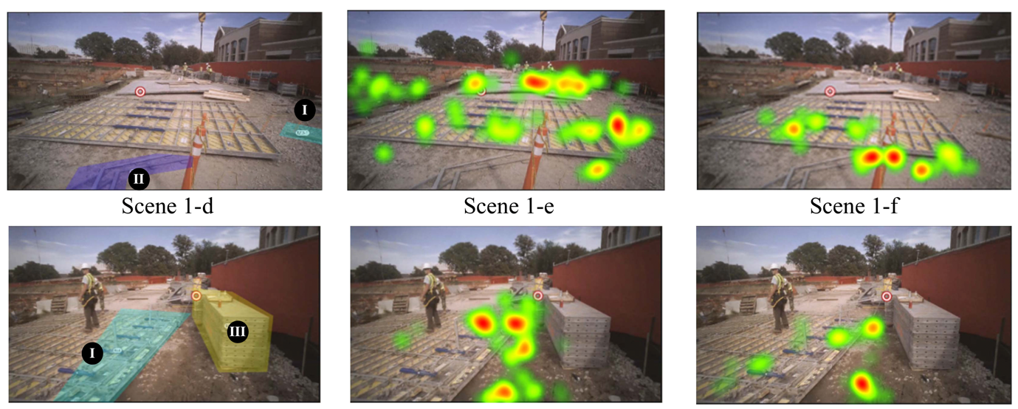
METHOD
INSTRUMENTS
TEACHER - EYE TRACKING DATA
Heatmaps
Duration and number of fixations on relevant AOIs
Theoretical Background • Research Question • Method

Slide 13
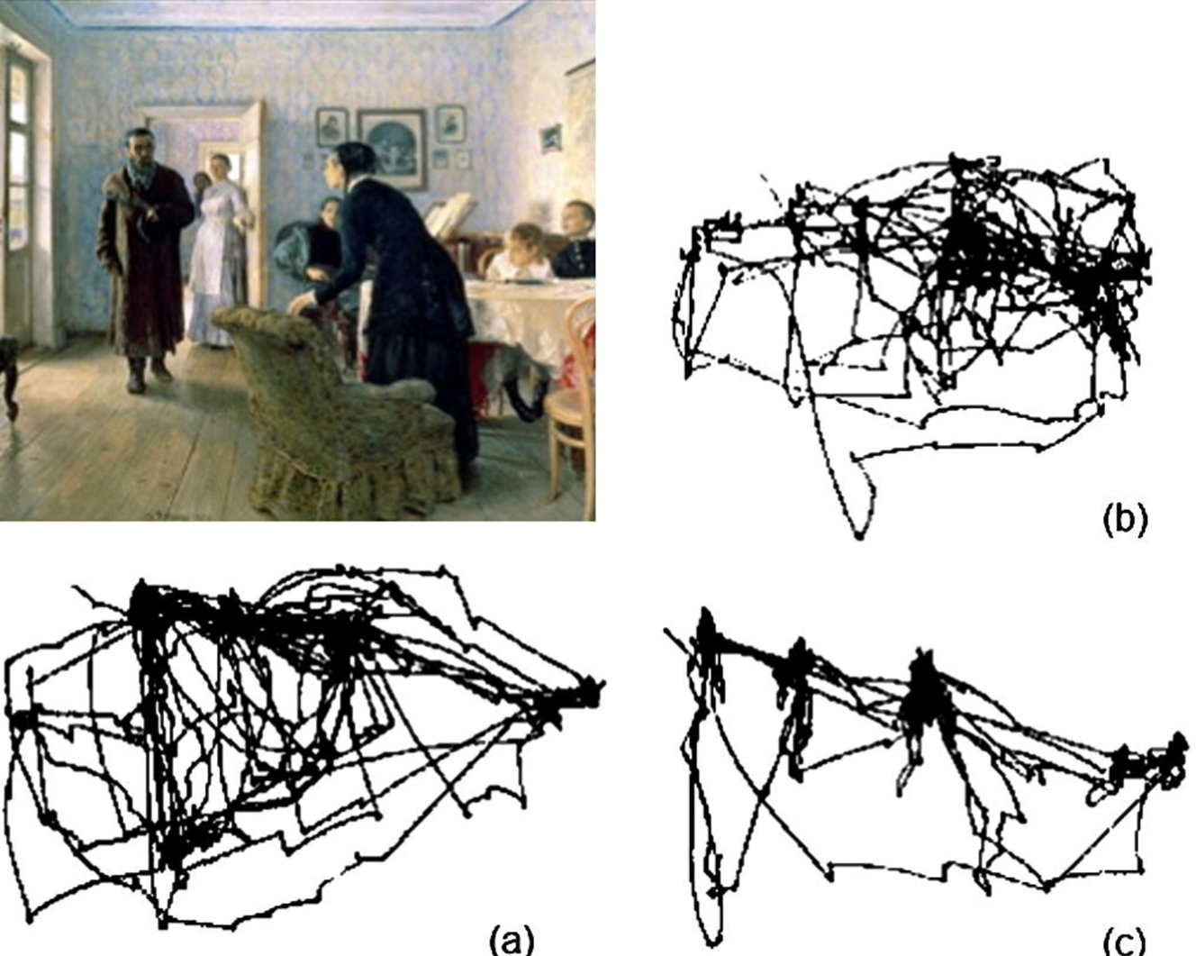
METHOD
INSTRUMENTS
TEACHER - EYE TRACKING DATA
Heatmaps
Scanpaths
Theoretical Background • Research Question • Method

Slide 14
METHOD
INSTRUMENTS
TEACHER - EYE TRACKING DATA
Heatmaps
Scanpaths
Duration and number of fixations on relevant AOIs
Theoretical Background • Research Question • Method

Slide 15
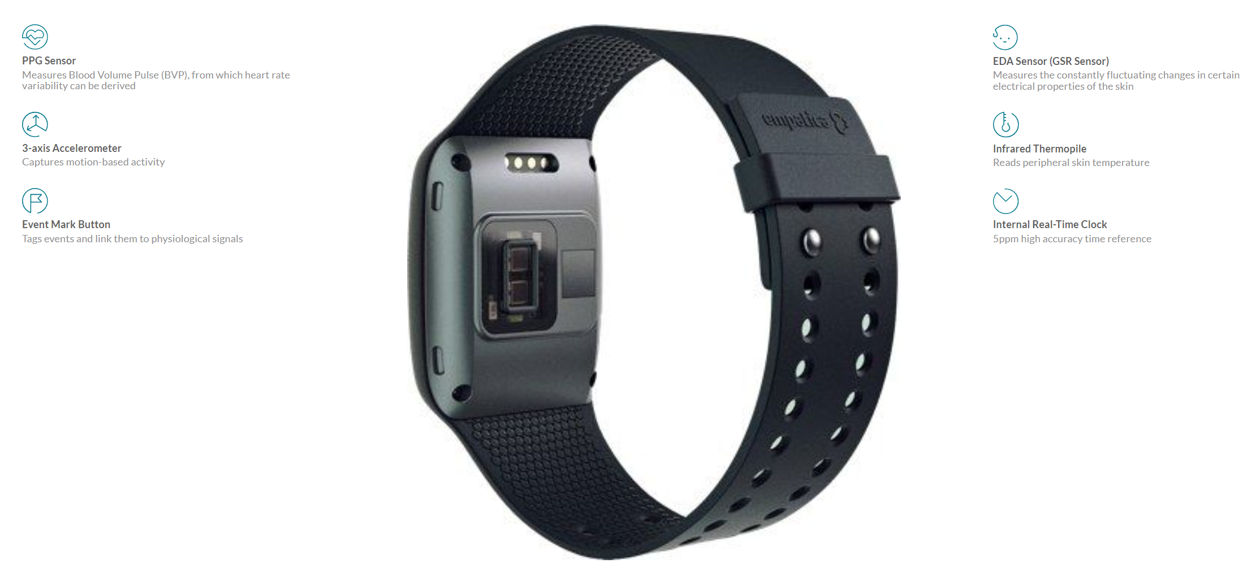
METHOD
INSTRUMENTS
TEACHER - PHYSIOLOGICAL DATA
electrodermal activity
heart rate variability
Empatica E4
Theoretical Background • Research Question • Method

Slide 16
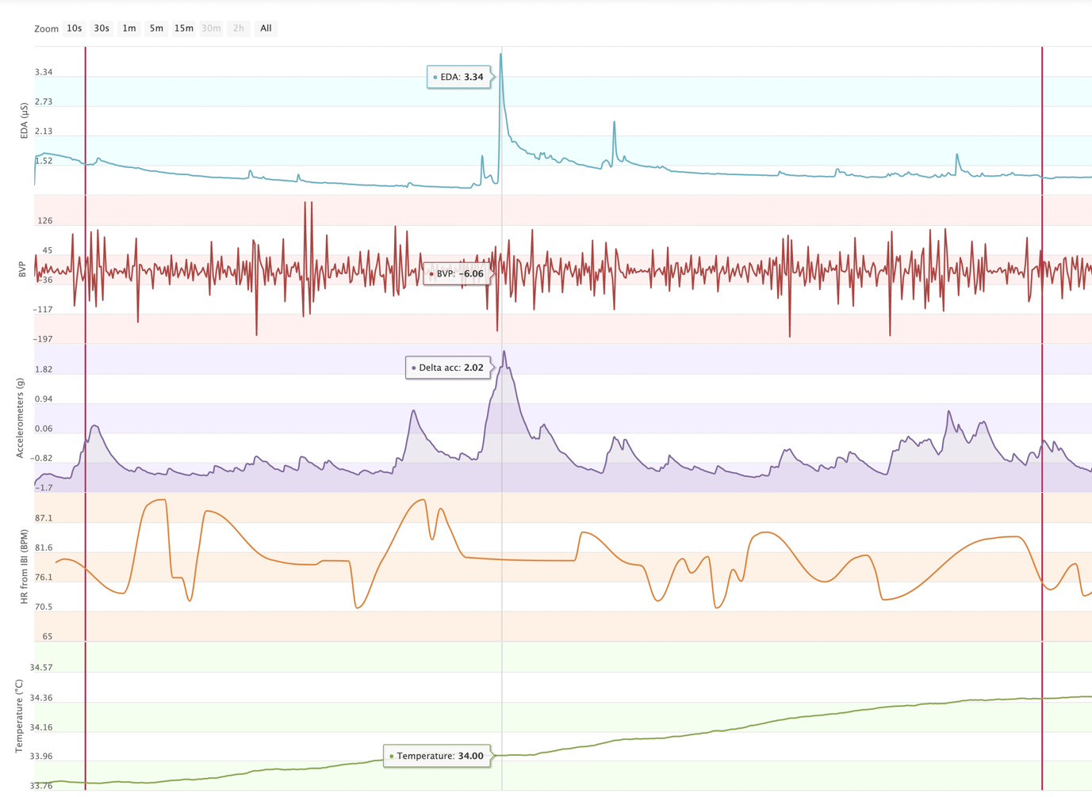
METHOD
INSTRUMENTS
TEACHER - PHYSIOLOGICAL DATA
Empatica E4
Theoretical Background • Research Question • Method • Preliminary Results • Limitations & Implications

Slide 17
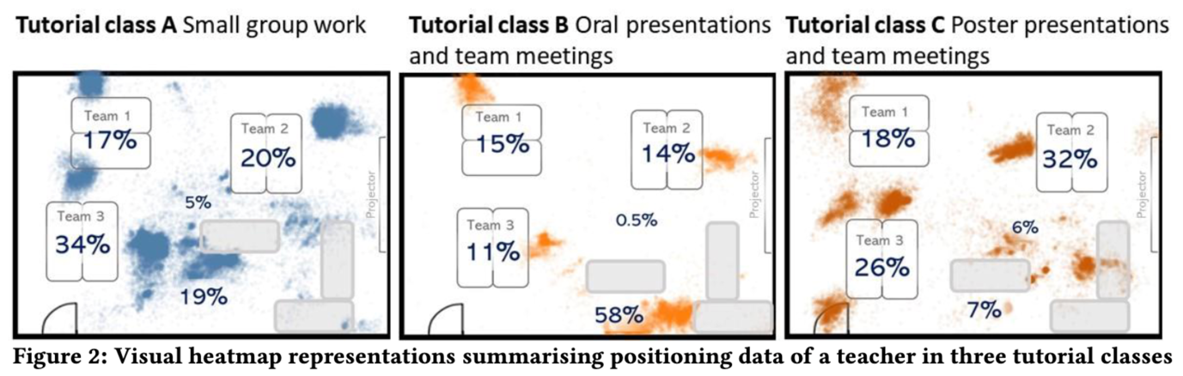
METHOD
INSTRUMENTS
TEACHER - BEHAVORIAL DATA
teachers’ position in the classroom via indoor tracking
Theoretical Background • Research Question • Method

Slide 18
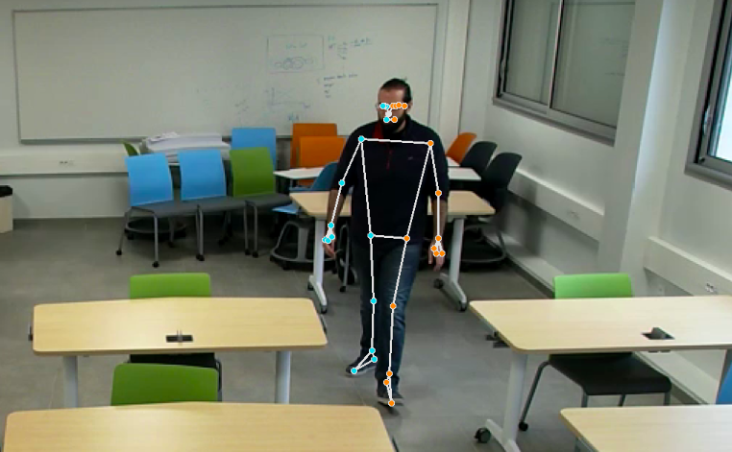
METHOD
INSTRUMENTS
TEACHER - BEHAVORIAL DATA
Body tracking via video data
Theoretical Background • Research Question • Method

Slide 19
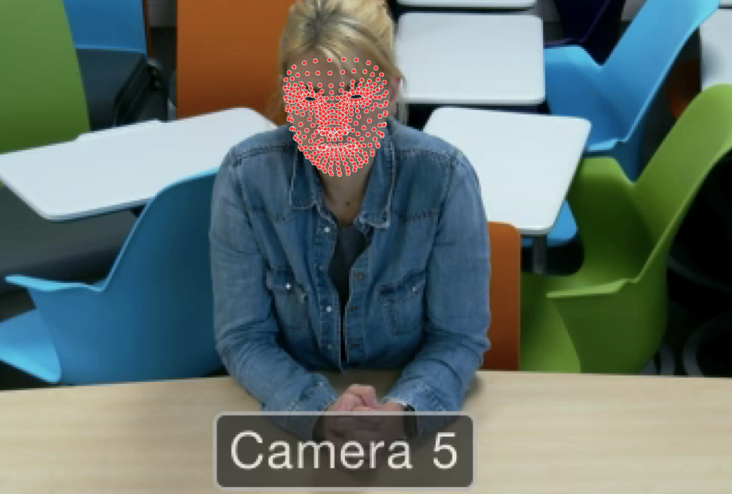
METHOD
INSTRUMENTS
STUDENTS - BEHAVORIAL DATA
Face detection via video data
Theoretical Background • Research Question • Method

Slide 20
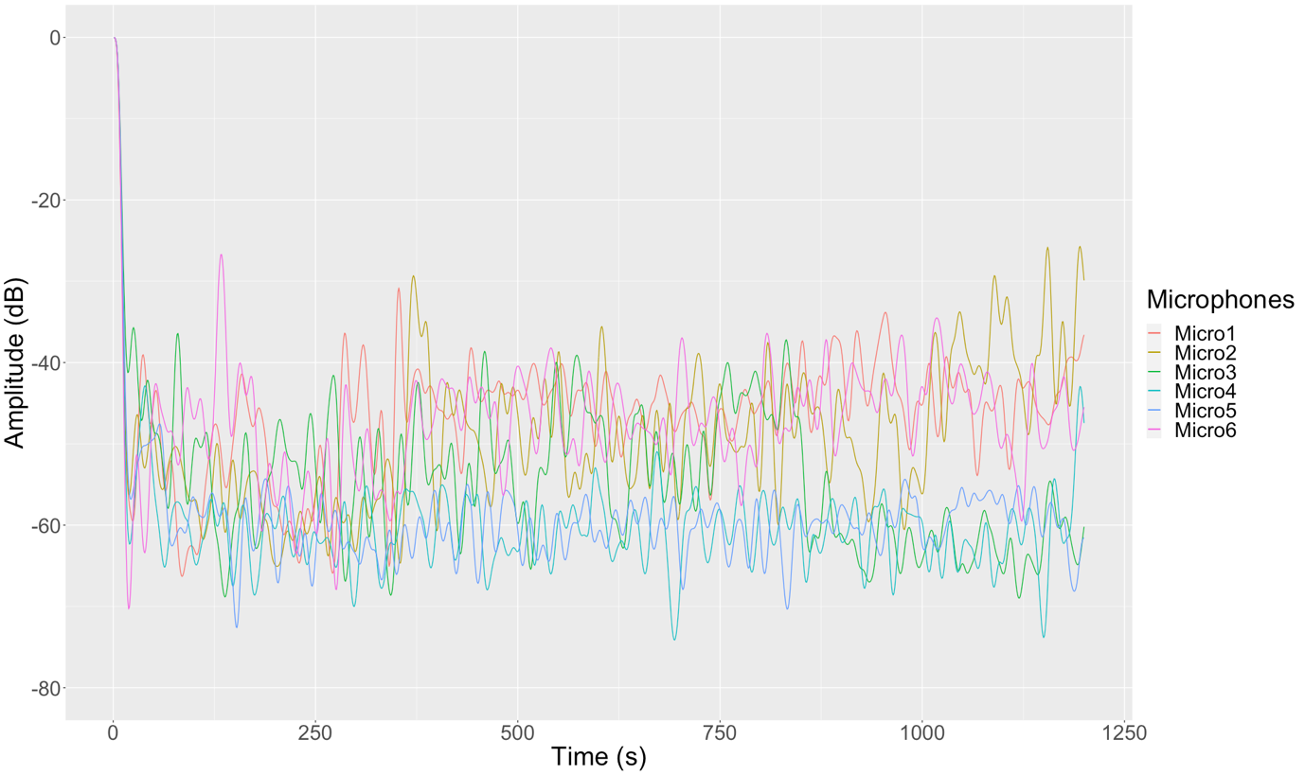
METHOD
INSTRUMENTS
STUDENTS - BEHAVORIAL DATA
volume in the classroom via audio data
Theoretical Background • Research Question • Method

Slide 21
METHOD
INSTRUMENTS
TEACHER - QUESTIONNAIRE DATA
Teacher self-concept (Retelsdorf et al., 2014)
  Self-concept subject related
Teacher self-efficacy (Schwarzer & Schmitz, 1999)
Questionnaires in French
Theoretical Background • Research Question • Method

Slide 22
METHOD
INSTRUMENTS
STUDENT - QUESTIONNAIRE DATA
Achievement goals (12 items questionnaire from):
Elliot, A. J., & Murayama, K. (2008). On the measurement of achievement goals: Critique, illustration, and application. Journal of educational psychology, 100(3), 613.
Anxiety state (Davey et al., 2007):
Before / After completing the XXX lesson, how anxious are you feeling at this moment? Likert scale with 11 boxes, between 0 "Not at all anxious" and 10 "Extremely anxious
Self-confidence (Krane, 1994):
Before / After completing the XXX course, how confident do you feel at this moment? Likert scale with 11 cells, between 0 "Not at all confident" and 10 "Very confident”
Enjoyment (Kim et al., 2016):
Before / After completing the XXX course, what is your level of enjoyment at this moment? Likert scale with 11 boxes, between 0 "No pleasure" and 10 "A lot of pleasure"
Theoretical Background • Research Question • Method

Slide 23
METHOD
DATA TREATMENT
Python: video analysis of the teachers (machine learning and posture/gesture detection) and of the students (face recognition, e.g. count the % of time student look at the whiteboard)
Boris: coding different event during the lessons (coding must be done by a native French speaker)
DaVinci resolve 18 / Adobe Premiere: synchronize video and audio recording (based on clap)
Audacity / Adobe Audition: to denoise the audio signals
Tobii Pro Lab: analysis of eye tracking data from Tobii Glasses 3
Theoretical Background • Research Question • Method

Slide 24
METHOD
DATA TREATMENT
Empatica E4 connect (online): data from the bracelet → physiological measures (text files)
Quuppa (indoor tracking): data from the indoor tracking system (text file)
MIT App Inventor OU Unity 3D: to create the questionnaire on tablets
JavaScript: to create online app for clap and get the UTC time (currently saved on CNRS Server) https://lpc-xp.cnrs.fr/Ampiric/Get_UTC_Time.html
CLASS: use the CLASS to detect the event on the video?
https://education.virginia.edu/research-initiatives/research-centers-labs/center-advanced-study-teaching-and-learning/castl-measures/classroom-assessment-scoring-system
Theoretical Background • Research Question • Method

Slide 25

Theoretical Background • Research Question • Method

